Slide 1
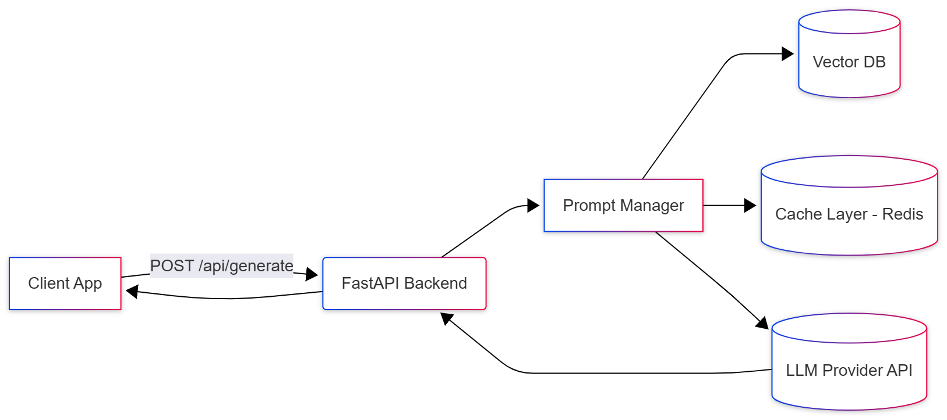
Module 3 – High-Performance AI Backend (FastAPI)
Goal: Transforming AI logic into a scalable, production-ready web service.
Why FastAPI? It is built on Asynchronous Server Gateway Interface (ASGI), making it one of the fastest Python frameworks available, rivaling Node.js and Go.
Core Pillars: Async execution, strict data validation, and real-time streaming.

Slide 2
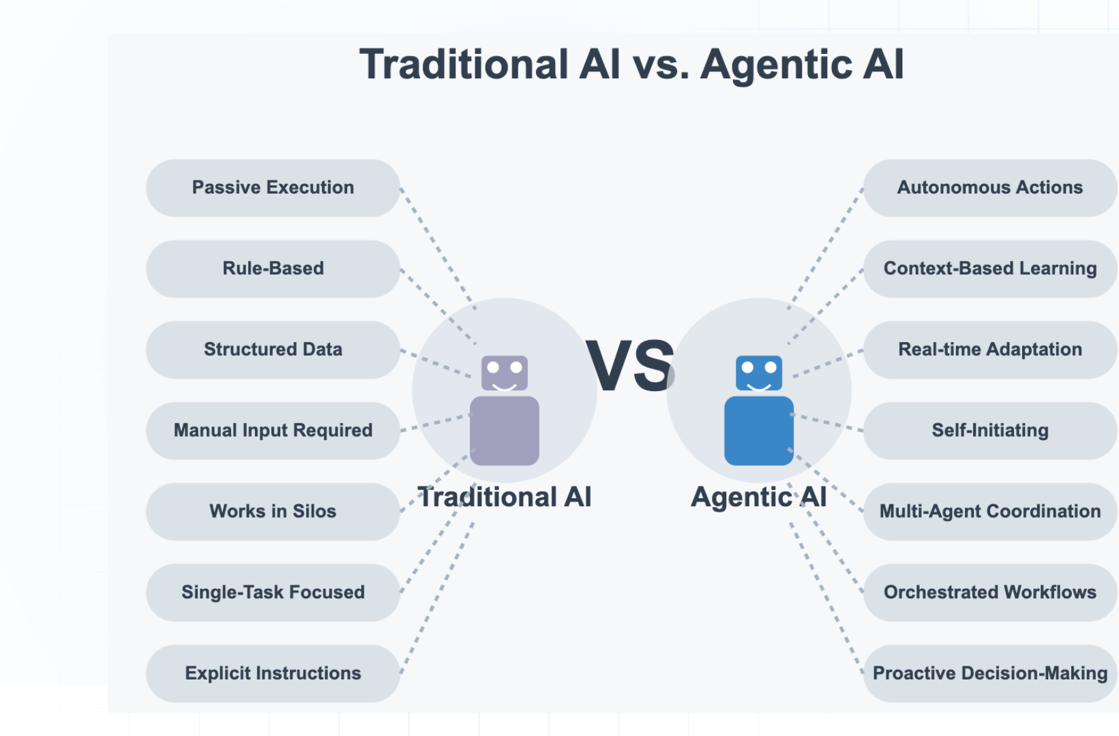
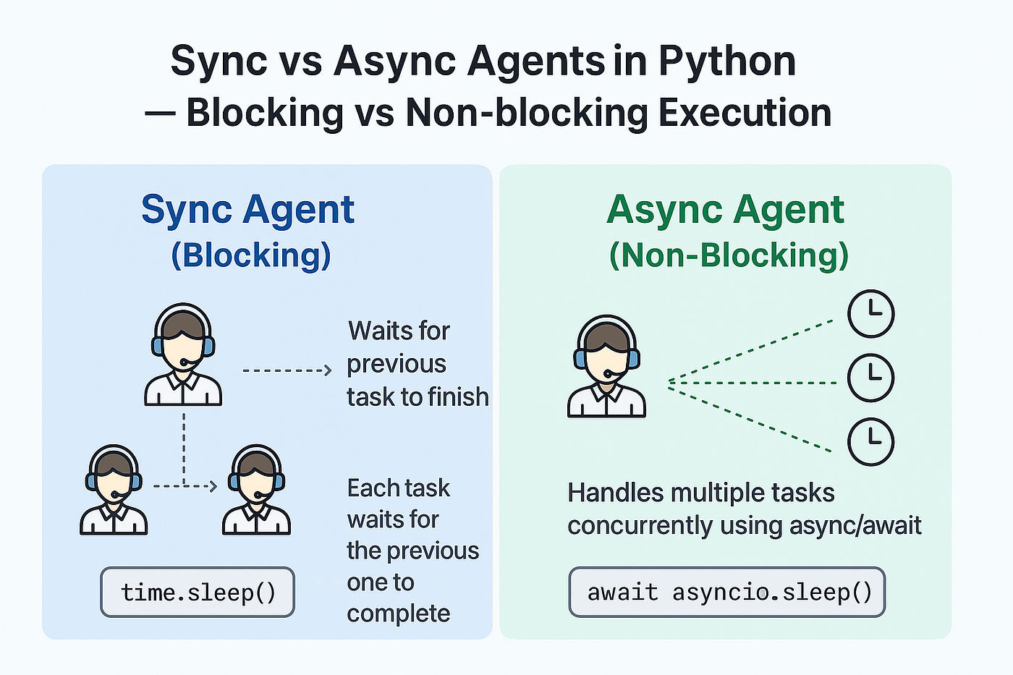
Data Validation & Async Logic
Pydantic: Using BaseModel to enforce strict schemas. This prevents "Type Errors" (e.g., sending a number where a string is expected) from crashing the server.
Asynchronous Inference: Utilizing async/await to ensure the server can handle hundreds of concurrent AI requests without blocking the main thread.

Slide 3
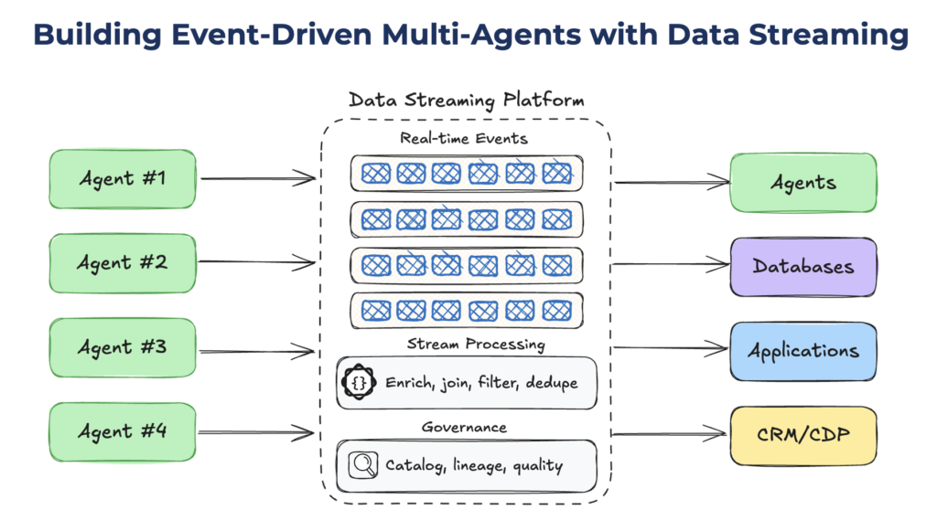
Real-Time Streaming (SSE)
Server-Sent Events (SSE): Instead of waiting for a full 30-second AI generation, we stream tokens one-by-one.
User Experience: This creates the "ChatGPT-style" typing effect, drastically improving perceived performance.
Auto-Docs: FastAPI automatically generates Swagger UI at /docs, allowing frontend teams to test the API instantly without reading manual documentation.

